Slide 1
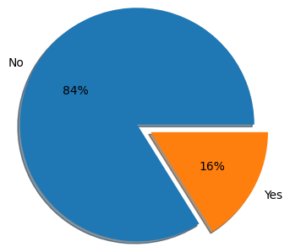
Topic : HR Analysis | Function For Company Efficiency | Industry : IT Industry
THE GOAL
The objective of this study are to know the reasons, why attrition occurs, to identify the factors which make employees dissatisfy.
To know the satisfactory level of employees towards their job and working conditions and to find the areas where companies are lagging behind.
THE DATA SET
This data set presents an employee survey from IBM, indicating if there is attrition or not. The data set contains approximately 1500 entries
Source - HR Dataset
THE IMPACT
Attrition has always been a major concern in any organization. The time, money and effort invested in training new employees, the work dependency and other factors leads to a massive overall loss to the firm when an employee leaves.
TECHNIQUE
Data Visualization
Statistical Analysis
Oversampling
ML - Classification
Survival Analysis
OUTPUT
There is 16% Attrition rate in the company

Slide 2

Introduction
HR analytics is the process of collecting and analyzing Human Resource (HR) data in order to improve an organization’s workforce performance.
HR analytics plays a role in every aspect of the HR function, including recruiting, learning/training and development, engagement, retention, compensation, attrition and benefits.
This method of data analysis takes data that is routinely collected by HR and correlates it to HR and organizational objectives.
Doing so provides measured evidence of how HR initiatives are contributing to the organization’s goals and strategies.

Slide 3
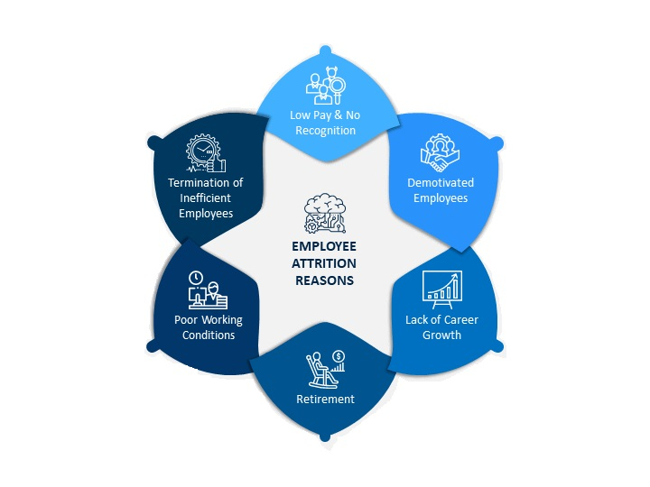
Attrition
Attrition is the departure of employees from the organization for any reason (voluntary or involuntary), including resignation, termination, death or retirement.
Attrition rate is the rate at which employees leave an organization divided by the average number of employees at the organization over a given period of time.
The objective is to improve the quality of people-related decisions, in order to improve individual and organizational performance.

Slide 4
Need for Analytics
They can help answer questions like:
What patterns can be revealed in employee turnover?
How long does it take to hire employees?
What amount of investment is needed to get employees up to a fully productive speed?
Which of our employees are most likely to leave within the year?
Are learning and development initiatives having an impact on employee performance?
To gain the problem-solving insights that HR Analytics promises.
Low attrition rate is desired by many companies because it implies that employees are satisfied with their workplace and the company does not have to train new recruits.

Slide 5
About Dataset
Dependent Variable : Attrition
Independent Variable (34 different variables in total) :
Basic Info: Age, Gender, Education, Education Field, Martial Status, Distance From Home
Work Info: Department, Job Role, Job Level, Over Time, Business Travel, Performance Rating, Stock Option Level, Job Involvement
Satisfaction: Work-Life Balance, Job Satisfaction, Relationship Satisfaction, Environment Satisfaction
Salary Related: Monthly Income, Monthly Rate, Daily Rate, Hourly Rate, Percent Salary Hike
Time Related: Total Working Years, Training Time Last Year, Years At Company, Years In Current Role, Years Since Last Promotion, Years With Current Manager, Num Companies Worked
Dataset Structure: 1470 observations (rows), 35 features (variables)
Data Type: Two datatypes in this dataset: objects and integers
Imbalanced dataset: 1233 (84% of cases) employees did not leave the organization while 237 (16% of cases) did leave the organization making our dataset to be considered imbalanced since more people stay in the organization than they actually leave.

Slide 6
Steps taken before Model Building
Importing Dataset
Feature Selection using RFE & SFS technique
Balancing Data using Random Oversampling and SMOTE
Understanding Data, Shape & Null values
Correlation between Continuous Variables
Exploratory Data Analysis

Slide 7
Data Pre Processing
Label Encoding | Outlier Treatment | Normalization | Oversampling
Categorical Variable BusinessTravel, Department, EducationField, Gender, JobRole, MaritalStatus, OverTime are converted into Encoding variable | Box plot is drawn for Independent features against Target variable and outlier had been detected. | Minmax Scalar function from Scikit learn library since the numerical variable are of different scale in order to obtain better performance. | Since our Dataset is highly imbalanced, we used Random oversampling technique in order to tackle class imbalance.
Attrition Feature is converted into binary value 0's and 1's | Since the outliers are legitimate, we have decided to retain them in data

Slide 8
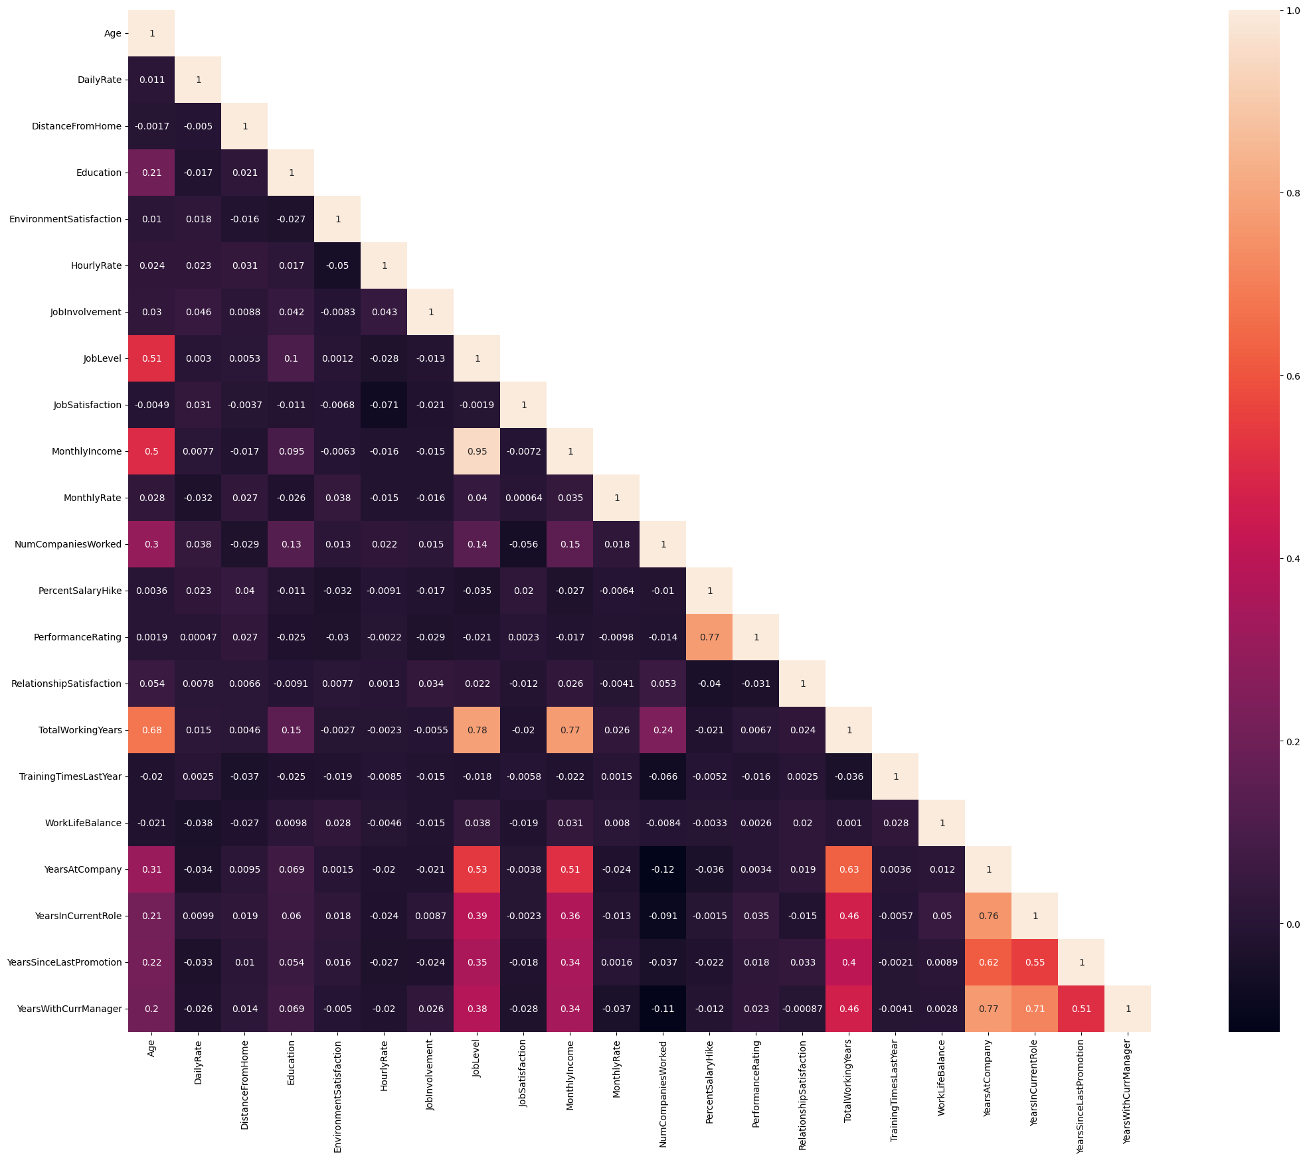
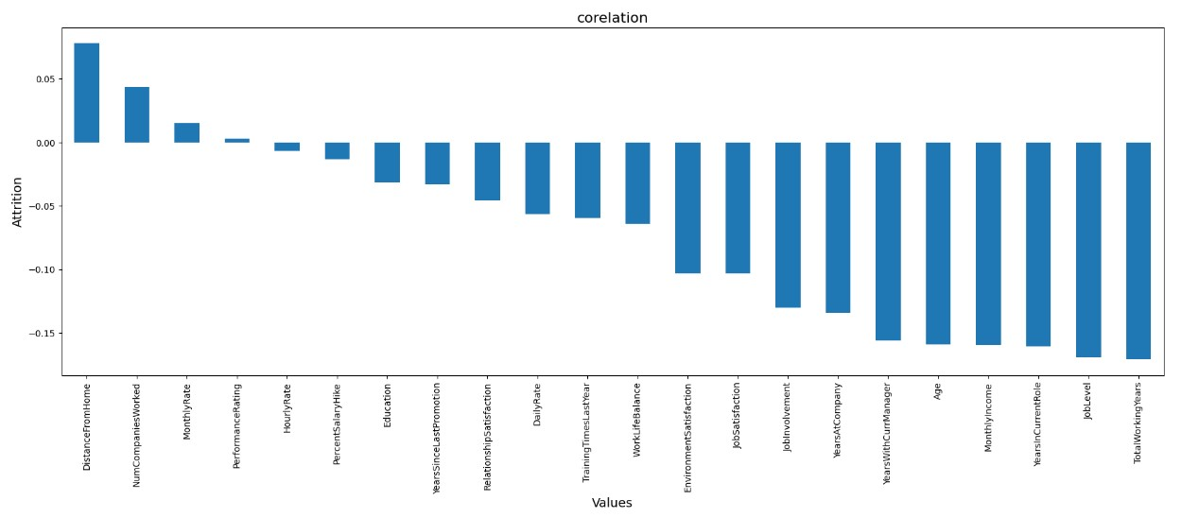
Correlation
Attrition has a negative correlation with monthly income, total working years, years at company, years in a current role, age.
Attrition has a positive correlation only with Distance from Home, NumCompaniesWorked , Monthly Rate.

Slide 9
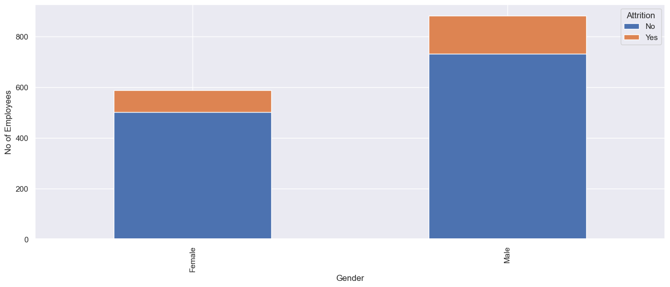
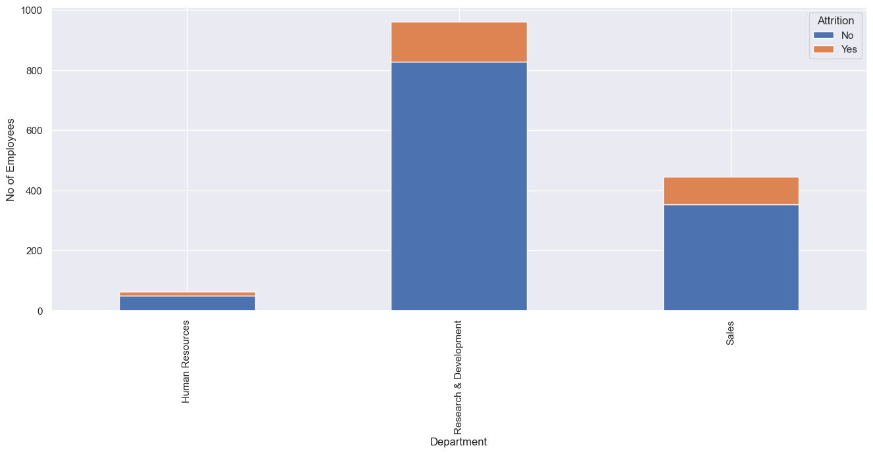
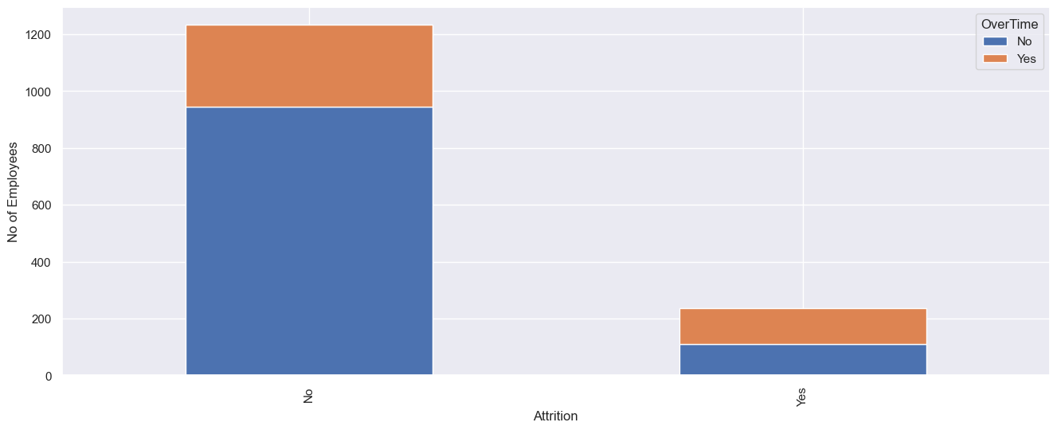
Data Insights
The majority of the employees working are males. There is a 3:2 gender ratio.
Male employees have a greater attrition rate than female employees.
Data comprises 3 major departments among which Sales department has the highest attrition rates (25.84%), followed by the HR Department (19.05%).
On the other hand, R & D have the least attrition rates, which suggests the stability of the department(13.83%)
Employee who does Overtime (28.30%) is less than those who do not (71.70%).
Attrition Rate of Overtime does (8.64%) is higher than their counterpart (7.48%)
People who do over time are likely to leave company more. It could be due to over workload

Slide 10
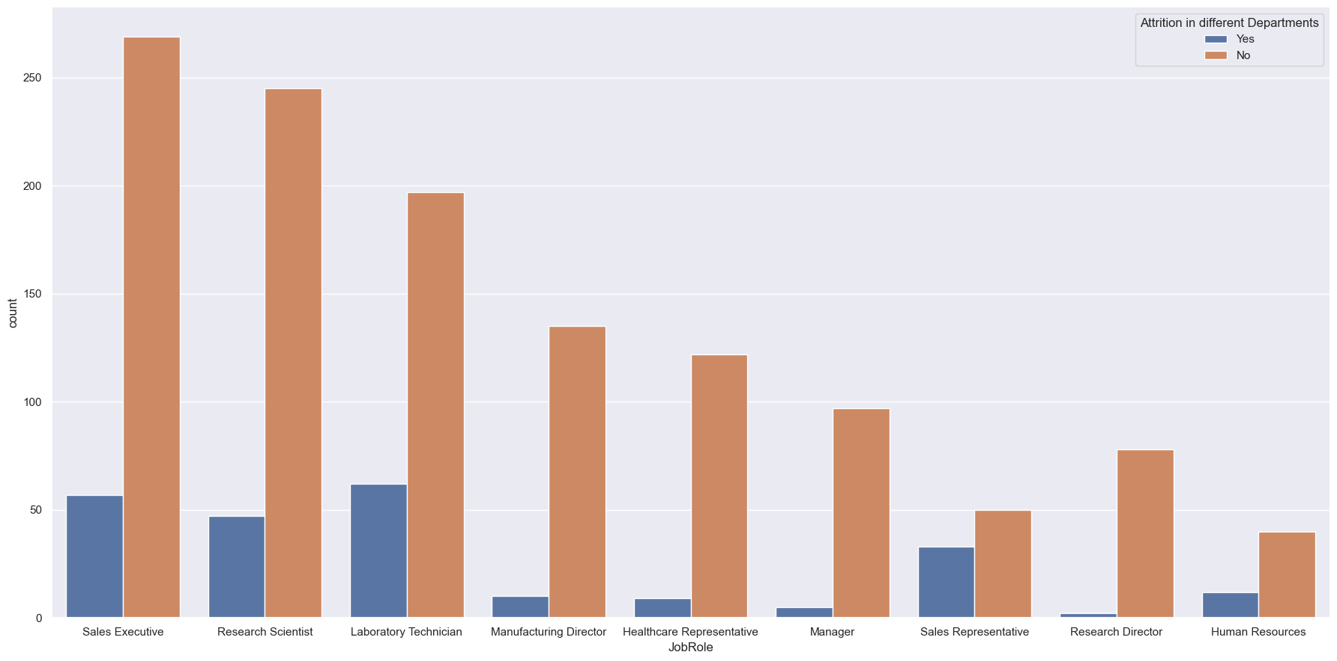
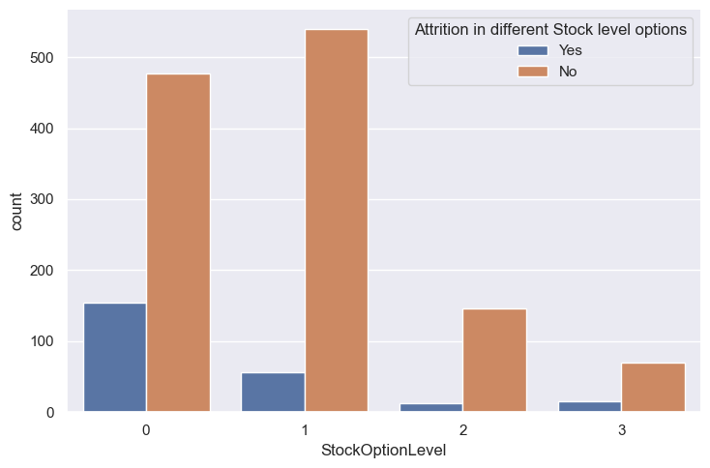
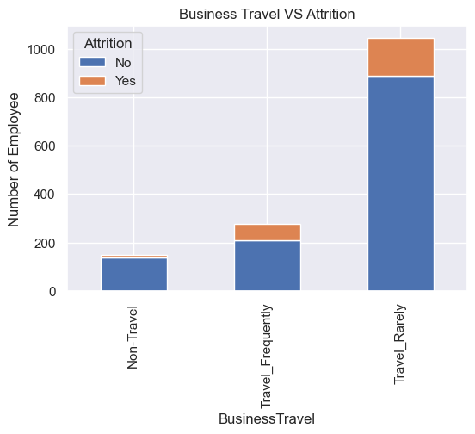
Employees Analysis
Employees might be attiring because they have a lower stock option level than other employees of same role
Employees with less stock options leaves the company more often.
There are high number of employees who travel rarely, followed by who travel frequently and non - travelers.
The highest number of Attrition rate is of the employee who travels rarely, while the lowest being the non - traveler one.

Slide 11
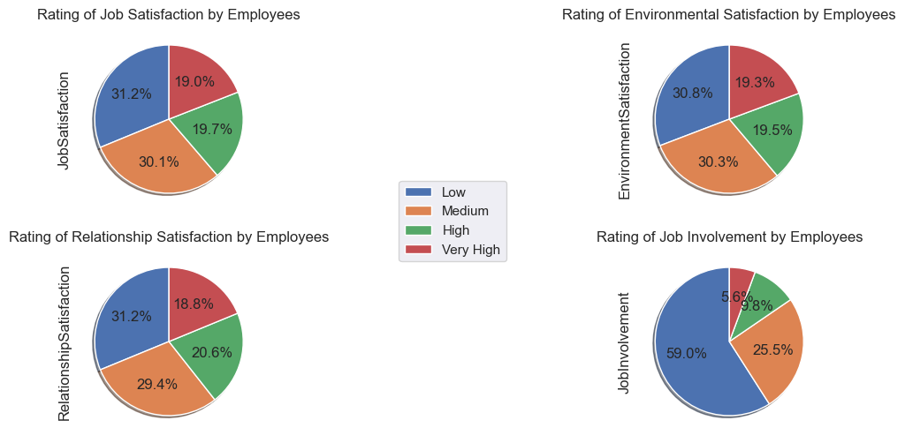
Employee Rating Satisfaction
From the subplot, we can infer that more than 60% of the employees are :
Not Satisfied in their Job.
Not Satisfied with their Work Environment.
Not Satisfied in their Relationship.
Not Getting involved in their job.
Almost 60 % of the employees have rated their work life balance as Bad.
Almost 85 % of the employees have a low performance rating.

Slide 12
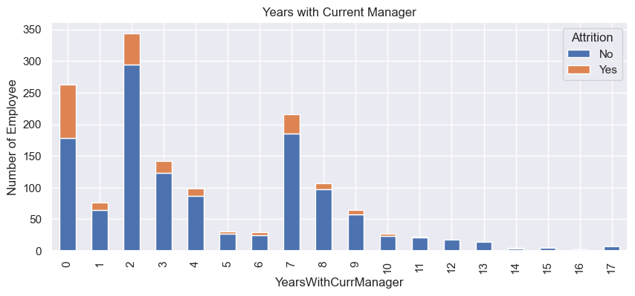
Employee Experience Analysis
At the very start, where the time spent with the manager is relatively less- people tend to leave their jobs- considering their relationship with their managers.
At an average span of 2 years, when employees feel they need an improvement, they also tend to go for a change.
When the time spent with the manager is slightly higher (about 7 years)- people tend to find their career progression stagnant, and tend to go for a change.
The number of employees who have worked for a shorter period of time are the ones who want to attire.
As the age increases, the total number of working years increases.

Slide 13
Approach 1 : Classification

Slide 14
Model Building
The F1 Score is a combined precision and recall measure of a model's accuracy.
A high F1 Score indicates that the model produced very few false negatives, indicating that we are correctly identifying real threats and are not influenced by false alarms.
When the F1 Score is 1, the model is considered successful ; when it is 0, the model is considered a failure.
Algorithm
Methods
 | Original Data | Random Oversampling | SMOTE
Random Forest | 0.1333 | 0.9372 | 0.8759
XG Boost | 0.2222 | 0.9156 | 0.9114
Decision Tree | 0.2667 | 0.9048 | 0.7795
Support Vector Machine | 0.0 | 0.7203 | 0.5557
Random Oversampling gives better results among other sampling methods.
Random Forest gives good F1 score.

Slide 15
Conclusion of Classification Approach
To summarize the results of the machine learning models produced on the IBM HR dataset, the Random Forest - Gini classification model predicted employee attrition with 93.72% accuracy on the test dataset, the XGBoost classification model predicted employee attrition with 91.56 % accuracy.
Organization should focus on the top needs of employees by motivating entry-level employees, increasing job satisfaction, and relationship satisfaction.
Factors contributing more to the employee attrition are MonthlyIncome, TotalWorkingYears, YearsAtCompany, YearsInCurrentRole, YearsWithCurrManager, OverTime, StockOptionLevel, JobLevel, JobRole.
Top three roles facing attrition
26% of employees who are likely to quit belong to Laboratory Technician group.
24% of employees belong to Sales Executive group.
19% of employees belong to Research Scientist group.

Slide 16
Suggestions
People are tending to switch to a different jobs at the start of their careers, or at the earlier parts of it. Once they have settled with a family or have found stability in their jobs, they tend to stay long in the same organization- Salary, Stock level options, Job level and Over time have a great motivation on the employees.
Estimate the number of employees required for each department so that the hiring process can be completed flawlessly and efficiently.
Work life balance is a great motivation factor for the employees.
Departments where target meeting performance is very much crucial (for e.g. Sales) tend to have a greater chances of leaving the organization as compared to departments with more administration perspective (For e.g. Human Resources)
People with a good Job Satisfaction and Environment satisfaction are loyal to the organization- and this speaks loud for any Organization. However, people who are not much satisfied with their current project- tend to leave the organization far more.
“Research indicates that workers have three prime needs: Interesting Work, recognition for doing a good job, and being let in on things that are going on in the company ”
-Zig Ziglar

Slide 17
Approach 2 : Survival Analysis

Slide 18
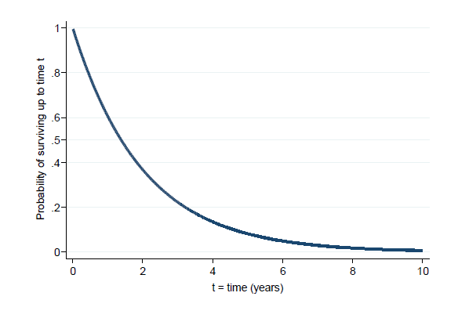
Introduction
HR survival analysis is a statistical method used to analyze the factors that influence employee attrition or turnover within an organization. The survival analysis approach focuses on the time it takes for an employee to leave the organization, also known as the survival time or time-to-event.
To estimate probability of not experiencing event of interest (not leaving=“surviving”) over any given time period (e.g. 5 year survival rate).
To compare overall survival experience between different groups of individuals.
Survivor function : Probability of not experiencing event of interest (“Surviving”) up to time t .

Slide 19
Censoring
If studying time till surviving for a particular population. Some employees may still be working at the end of the study period. Therefore the exact survival time for these subjects are unknown
These are called censored observations or censored times.
In essence, censoring occurs when we have some information about individual survival time, but we don't know survival time exactly.
Here our data is right censoring.
Censoring
Right
Censoring
Left
Censoring
Interval
Censoring
It means that we are not certain what happened to people after some point in time.
When we are not certain what happened to people before some point in time.
When we know that something happened in an interval but do not know exactly when in the interval it happened

Slide 20
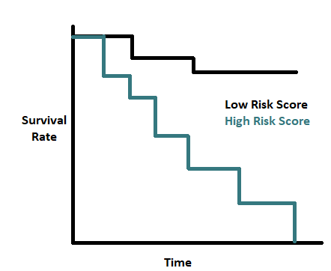
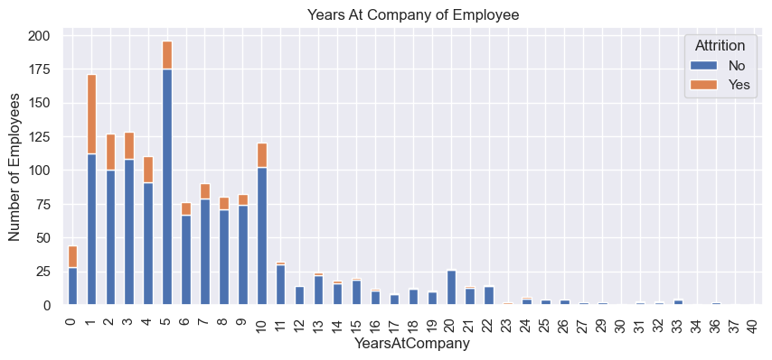
Kaplan Meier Estimator
The Kaplan-Meier estimator is a non-parametric technique of estimating and plotting the survival probability as a function of time.
The event status should consist of two mutually exclusive(2 events cannot both occur at the same time) and collectively exhaustive (at least one of the events must occur).
The time to an event or censorship (Known as the “survival time”) should be clearly defined and precisely measured.
Most employees leaving this organization are between from 1 to 5 years.

Slide 21
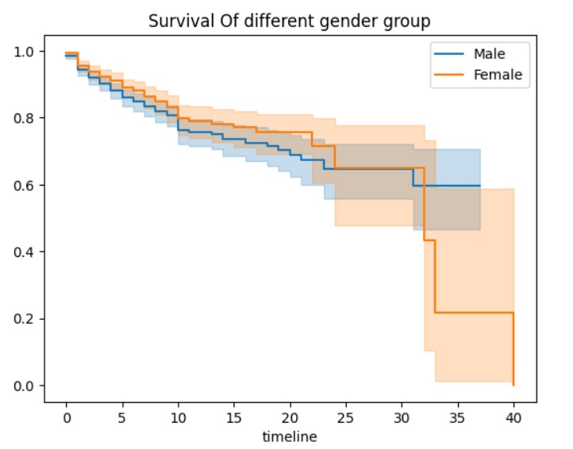
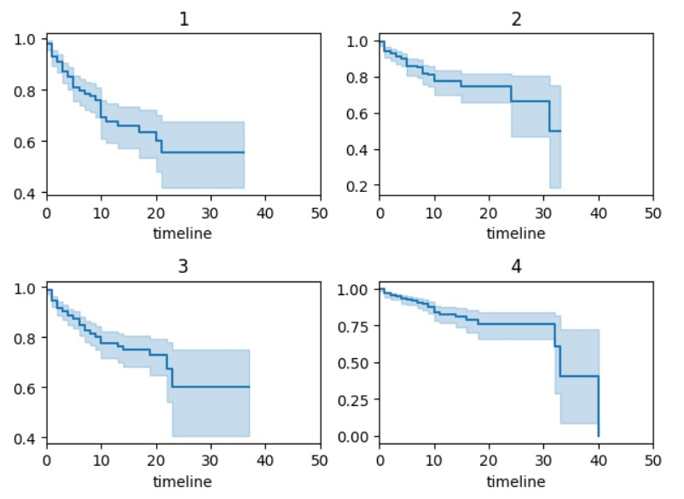
Kaplan Meier Estimator
We can see that probability of an individual working in a company more than 5 years at the company is 87% however probability of working longer than 15 years is dropped to 75%
Employees Rated Job Satisfaction as ‘1’ have low probability to survive in the company than others who have rated ‘4’.

Slide 22
Thank You!

